Slide 1
How to Run a Successful Genomic Epidemiology Training Program

Slide 2
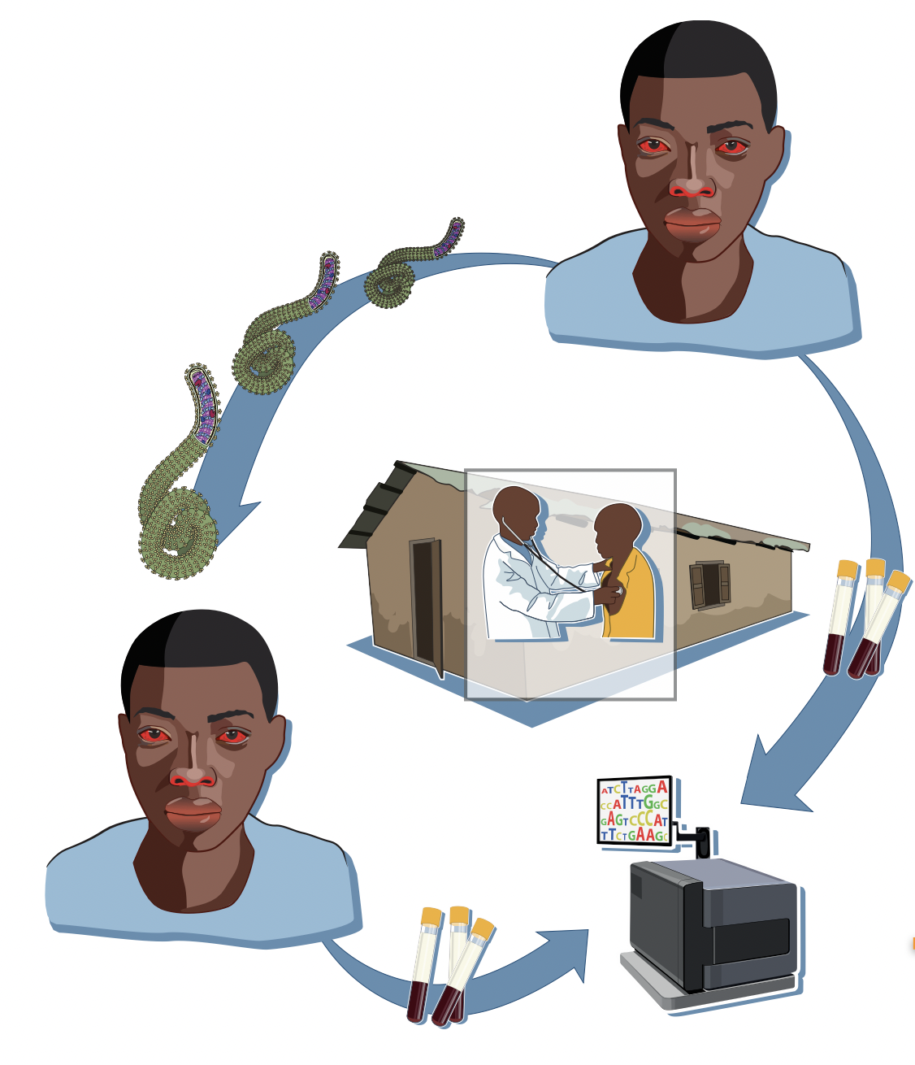
What is pathogen genomic epidemiology ?
Epidemiology of infectious diseases using pathogen sequencing
Sequencing: determining the nucleotide composition of a genome
Genome: the set of genetic information in an organism
Genomic epidemiology is central to infectious disease public health surveillance
Andersen et al. 2015.

Slide 3
Genomic epidemiology is a discipline where we seek to understand the distribution of infectious diseases in a population and determinants of those patterns from pathogen genetic sequence data.

Slide 4
Genomic epidemiology can inform public health action.
Helping us understand the contributions of different epidemic processes to outbreaks.
Investigating possible linkages between cases.
Evaluating how well our interventions are performing.
Notes:
Contributions: allowing us to tailor interventions and focus where biggest problems are:
Linkages: validating contact tracing inferences, and highlighting possible discrepancies or unreported exposures.
Evaluations: get critical feedback on how well our response efforts are working!

Slide 5
Objectives of the Training Program
Course description.
Specific goals and outcomes for participants.
Target audience (e.g., epidemiologists, public health professionals, lab technicians).
Duration and format of the program.

Slide 6
Curriculum Design
Core topics to cover (e.g., sample design, sequence alignment, phylogenetic analysis, etc).
Hands-on training components.
Balance between theoretical knowledge and practical skills.

Slide 7
Faculty and Facilitators
Importance of experienced educators and researchers.
Collaboration with universities, research institutions, and public health organizations.
Guest lectures and workshops by leading experts.

Slide 8
Integrating Technology and Tools
Overview of essential genomic epidemiology tools and software.
Incorporating data analysis and bioinformatics training.
Access to genomic databases and resources.

Slide 9
Case Studies and Real-world Applications
Use of case studies to illustrate concepts.
Encouraging problem-solving and critical thinking.
Interaction with ongoing research and public health initiatives.

Slide 10
Assessment and Evaluation
Methods for assessing participant progress (projects, practicals, etc).
Continuous feedback mechanism.
Certifications and credits for professional development.

Slide 11
Challenges and Solutions
Common challenges in genomic epidemiology education (e.g., resource limitations, keeping pace with rapid advancements).
Strategies to overcome these challenges.

Slide 12
Future Directions and Opportunities
Emerging trends in genomic epidemiology.
Future skill requirements and job opportunities.
Long-term impact of the training program on public health

Slide 13
Conclusion
Summarize key points.
Encourage participation and collaboration.
Contact information for further inquiries.

Slide 14
Q&A
Invite questions from the audience.
Remember to use visuals like graphs, charts, and relevant images to make the presentation engaging. Also, consider the background of your audience to tailor the complexity of the content accordingly.

Slide 15
Questions?

